Slide 1
Mobile App
Notes:
Additional details will be found on the Tip Sheet. Tip Sheet and updated slides will be available by the end of Sept. 2023.

Slide 2
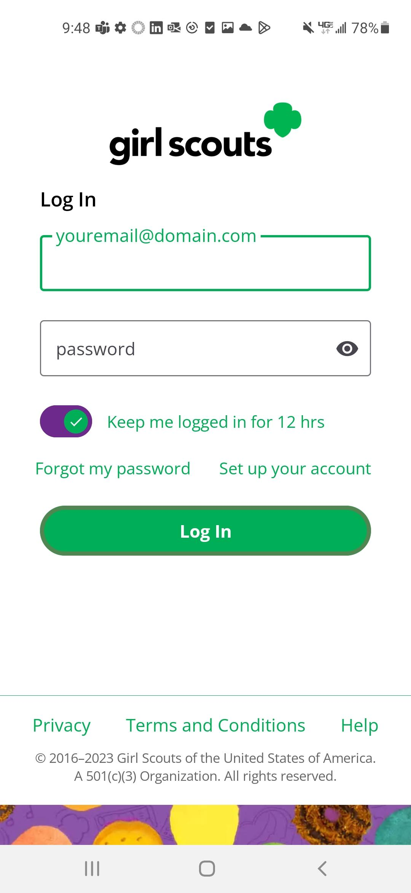
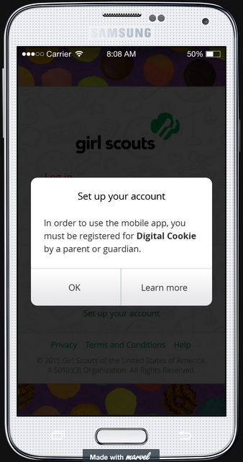
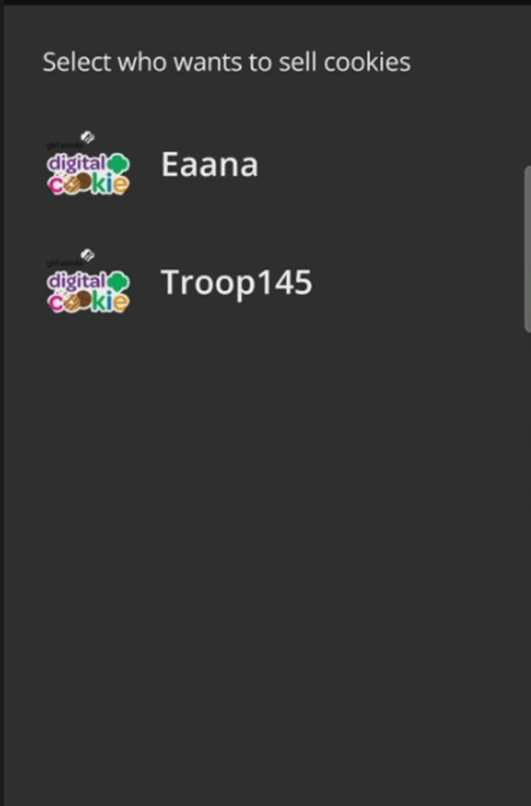
Mobile App-Logging In
Download the mobile app from the app store
Log in to the app using the same email and password created in Digital Cookie.
Girl Scout and troop sites must be set up in Digital Cookie using a browser first, before accessing the mobile app.
Select from the Girl OR the Troop persona. Troop login means the sales go to the whole troop-like at a booth.
Notes:
Users should Download a new version of the Digital Cookie App each year.
Girl Scouts must have their site set up and approved prior to being able to log into the cookie app.
Troop must have troop site set up for the troop option to appear
Once logged in, the user will select which account to use to take the cookie sale (Girl Scout or Troop).

Slide 3
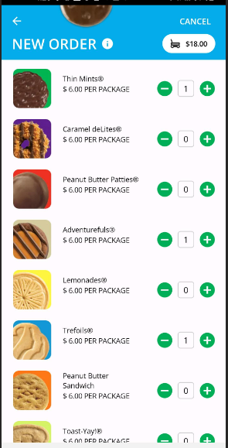
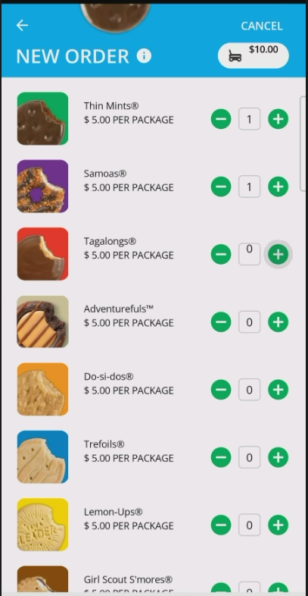
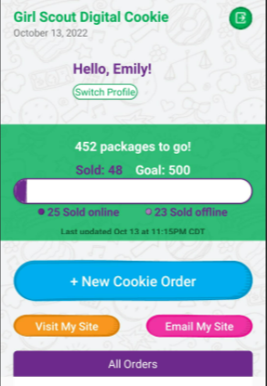
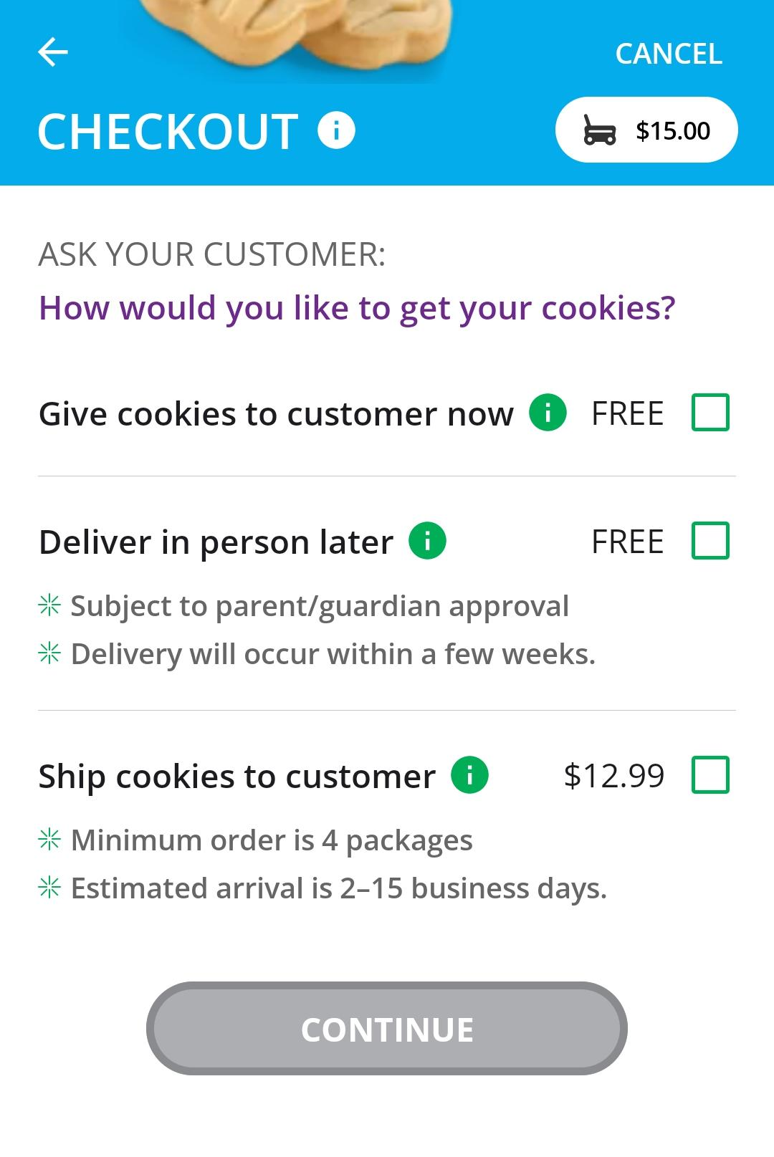
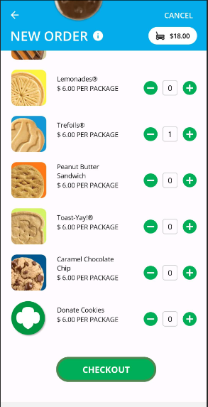
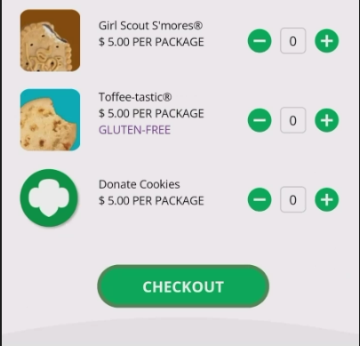
Mobile App-Making a Sale
Taking an order and viewing your orders are the main functions.
Enters the customer’s order, click Checkout to continue.
Girl can select to “Give cookies to customer now” for face-to-face transactions.
Notes:
Note to council: Select which image has the correct cookies and delete the other.
Then you will arrive at the home page, to create a new order click the New Cookie Order button.
Enter the number of cookies and varieties the customer is ordering, by using the plus and minus signs next to each cookie variety.
At checkout select the delivery method, most likely option is “Give cookies to customer now” if they are making a face-to-face sale.

Slide 4
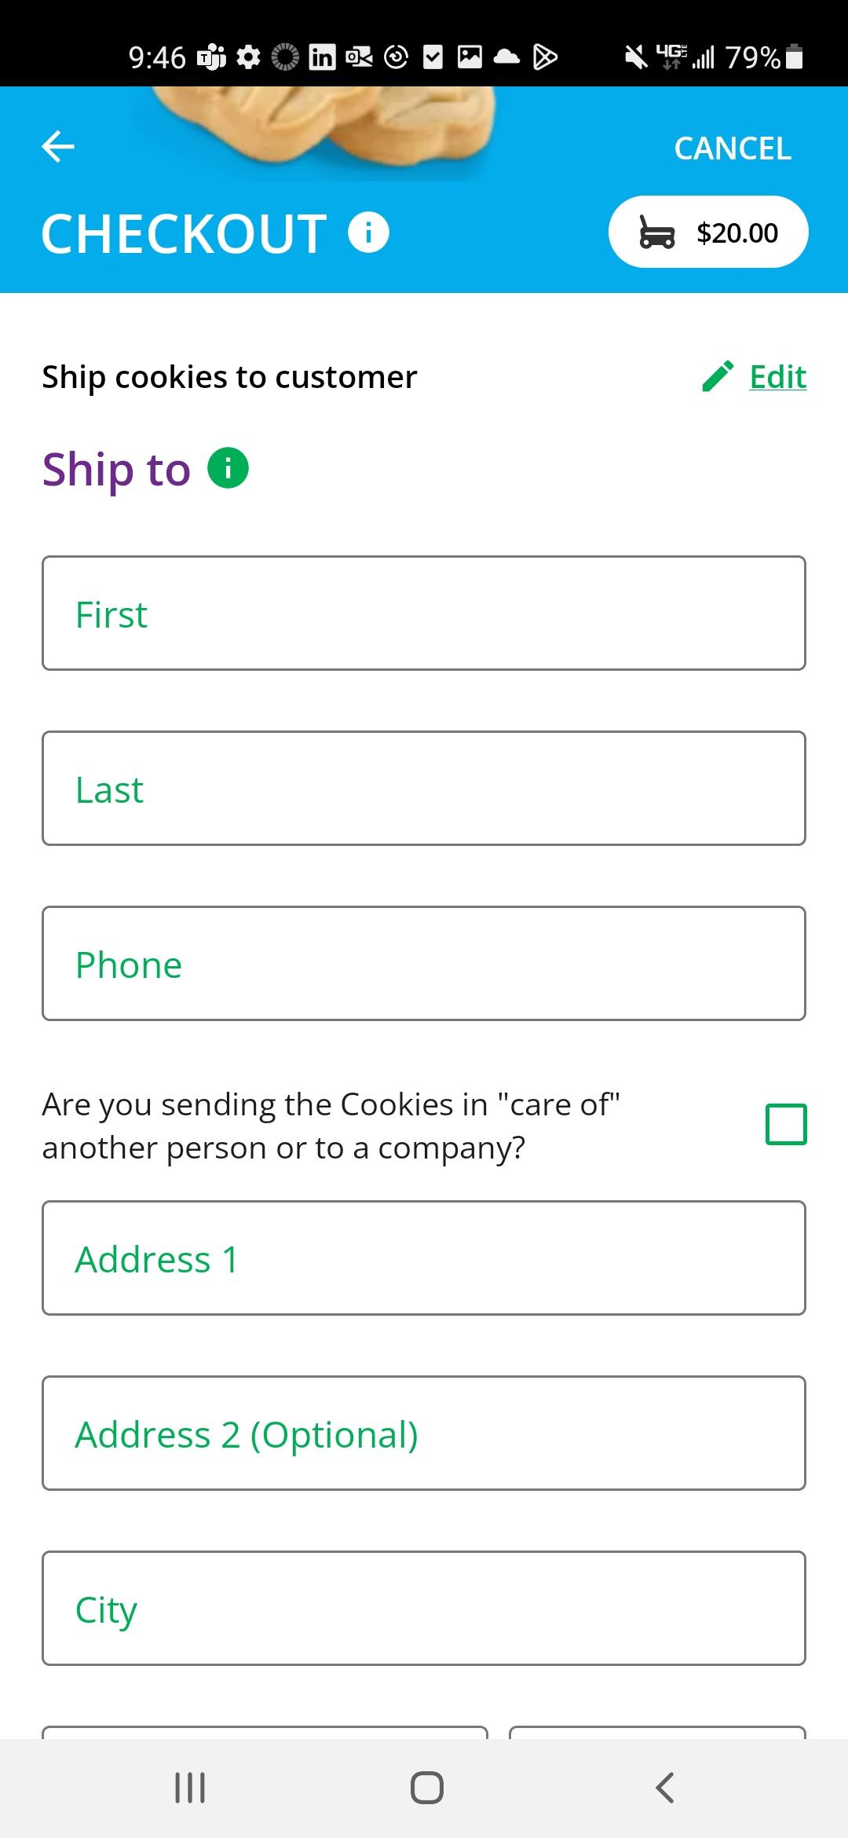
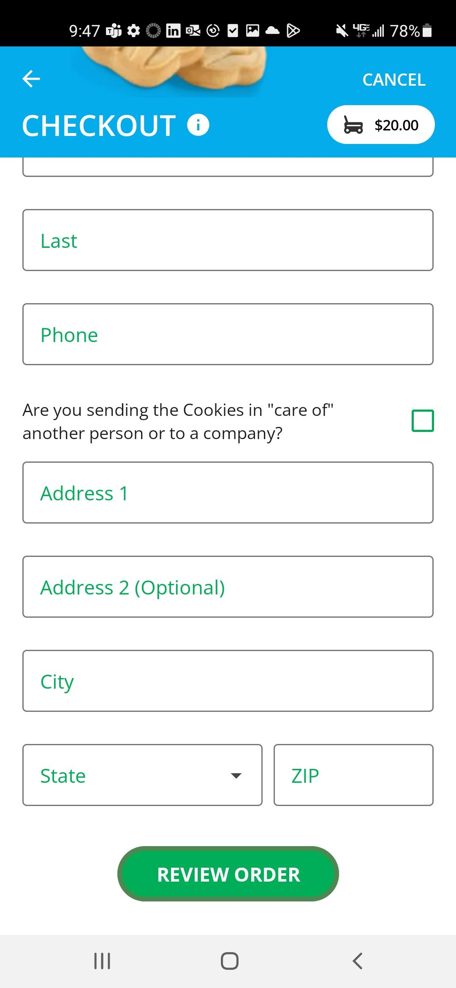
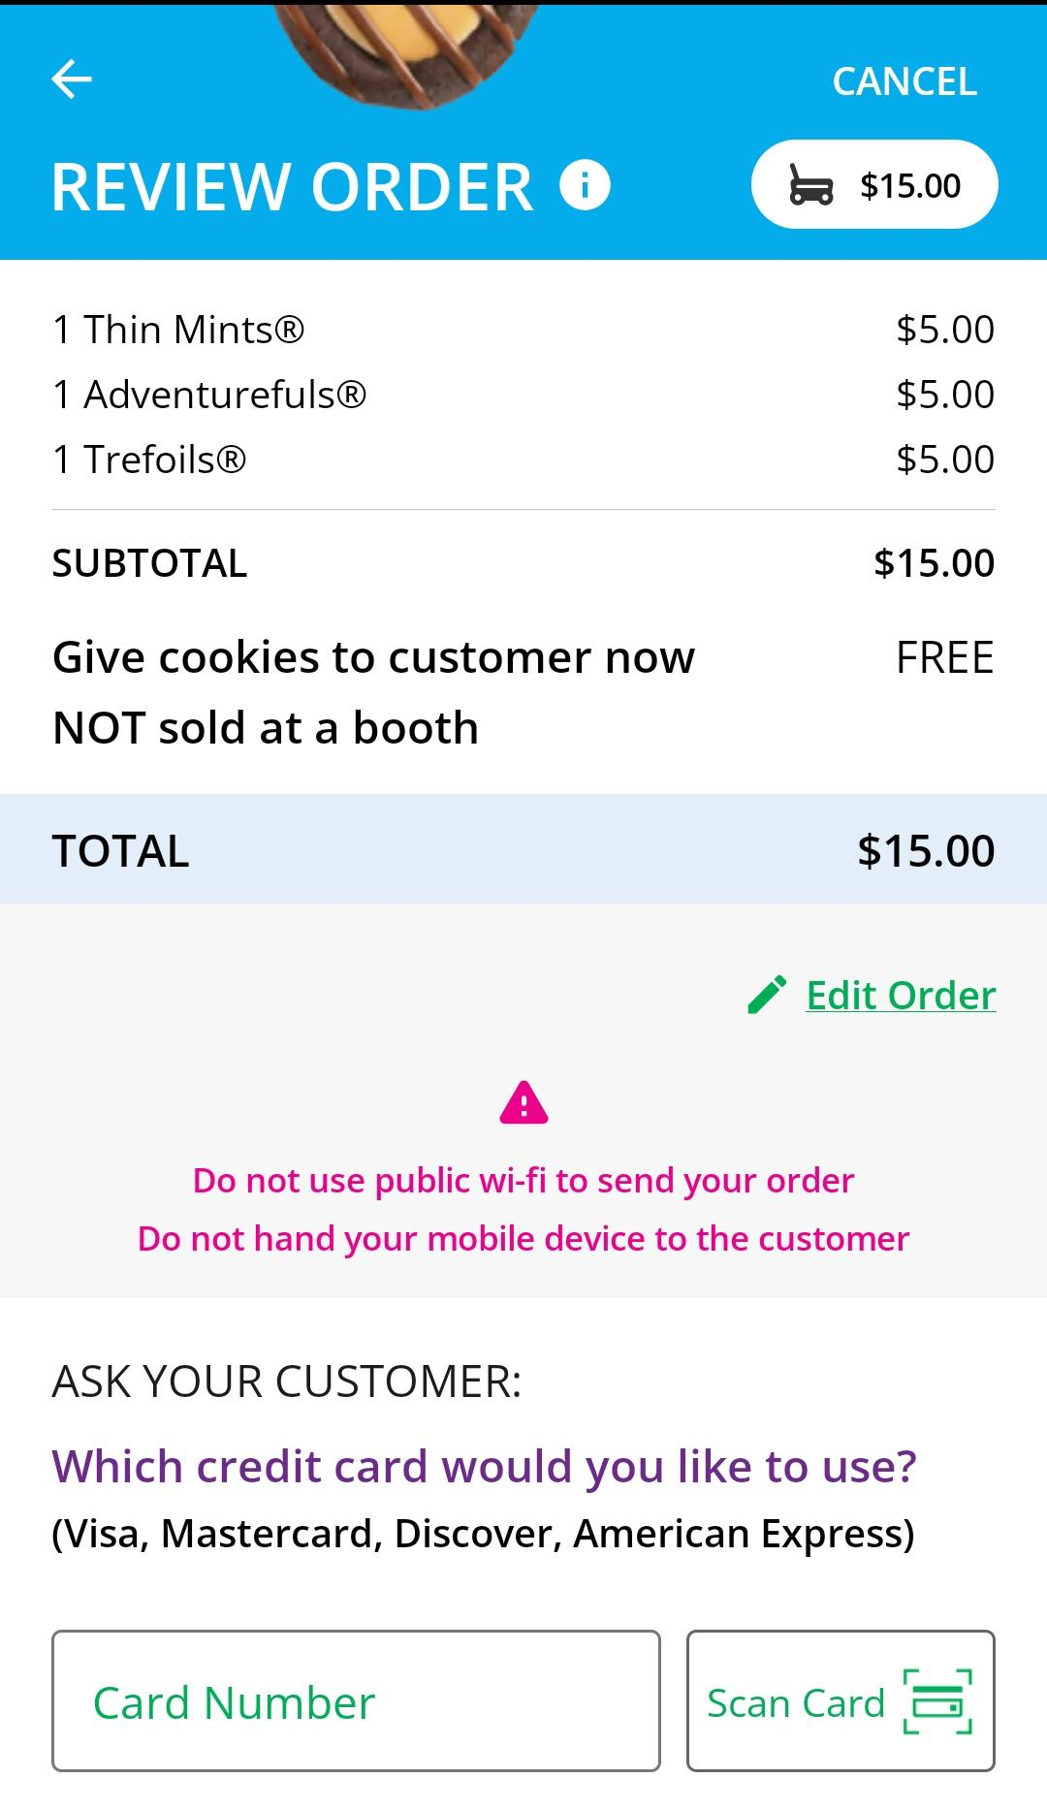
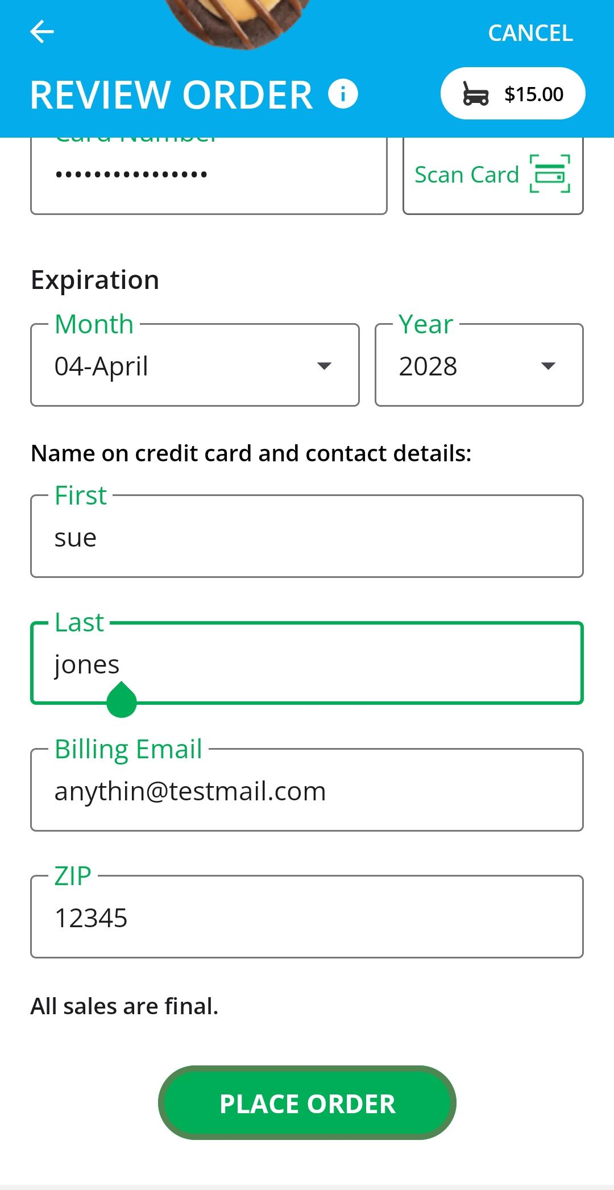
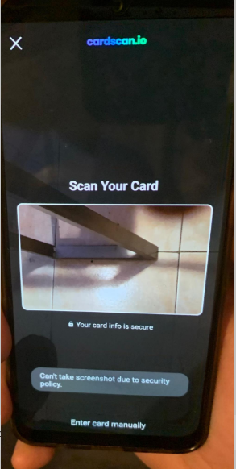
Mobile App-Making a Sale
Delivery or shipped orders
In-hand (Give cookies to customer now) orders
Scan Card
Notes:
Note to council: Select which image has the correct cookies and delete the other.
If the order is a shipped or delivery order, the girl will then complete the customer information for where the cookies will be shipped/delivered to.
For in hand orders (give cookies to customer now), an address is not required, only the customer’s name, email address, and billing Zip Code.
When entering the credit card information for all types of orders, there is the Scan Card feature to use rather than having the customer verbally tell the Girl Scout their credit card number.

Slide 5
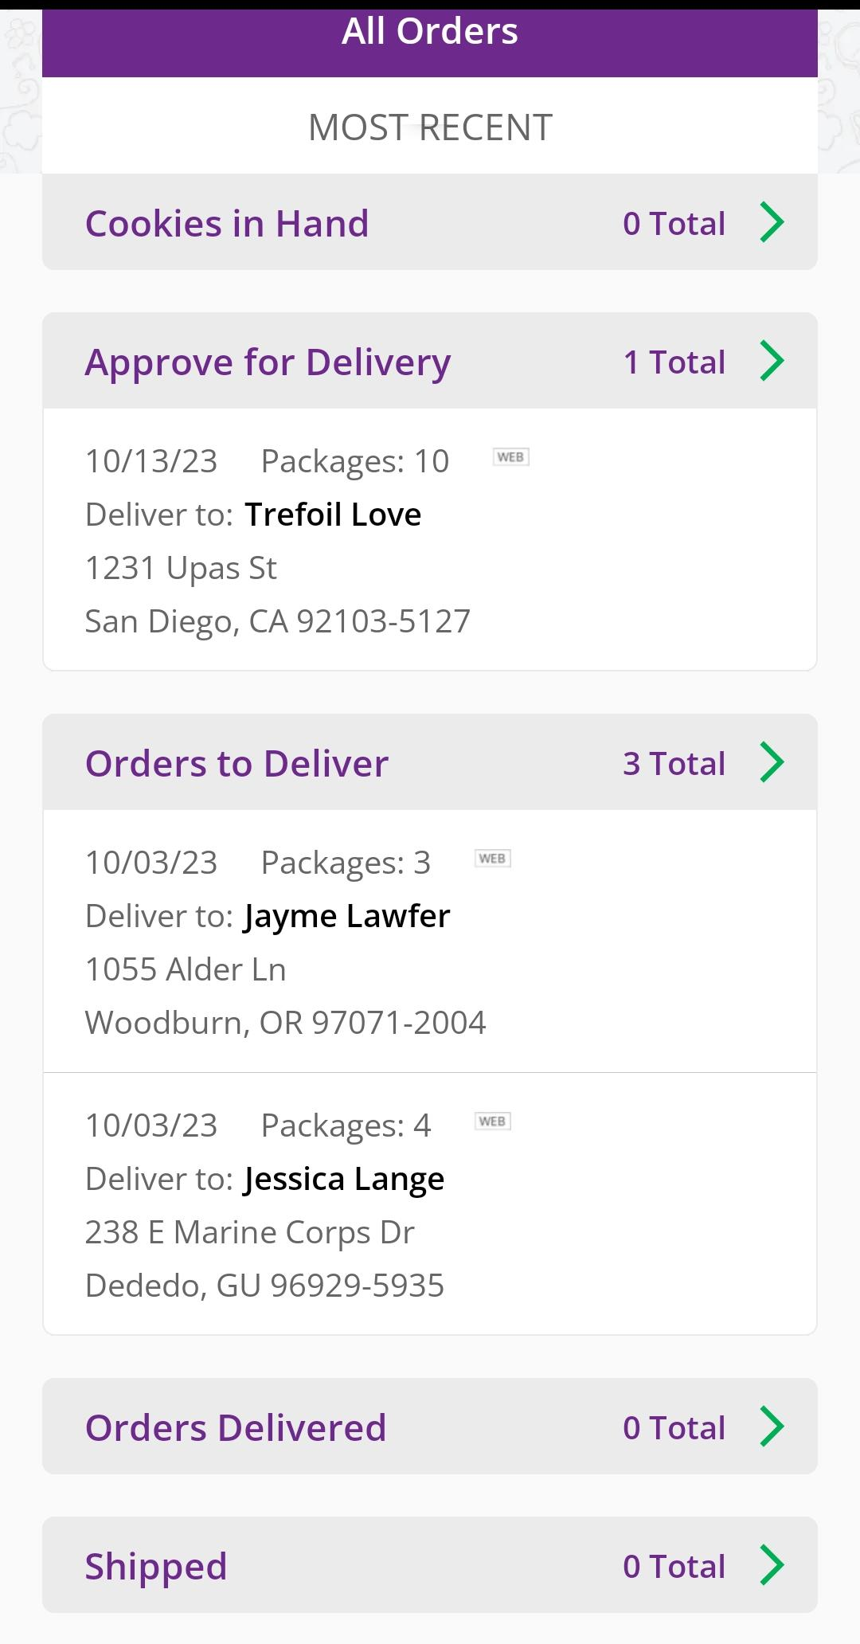
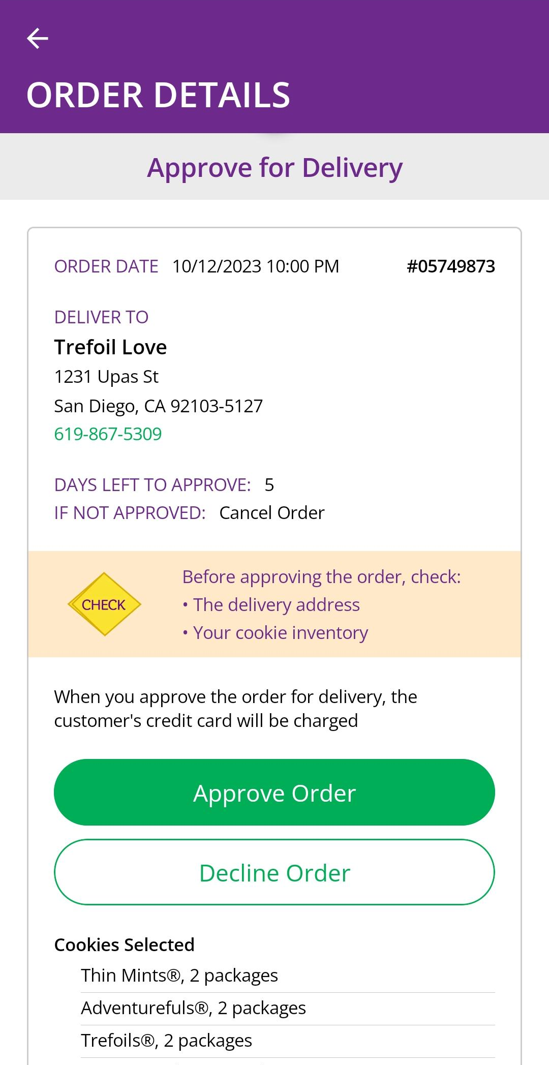
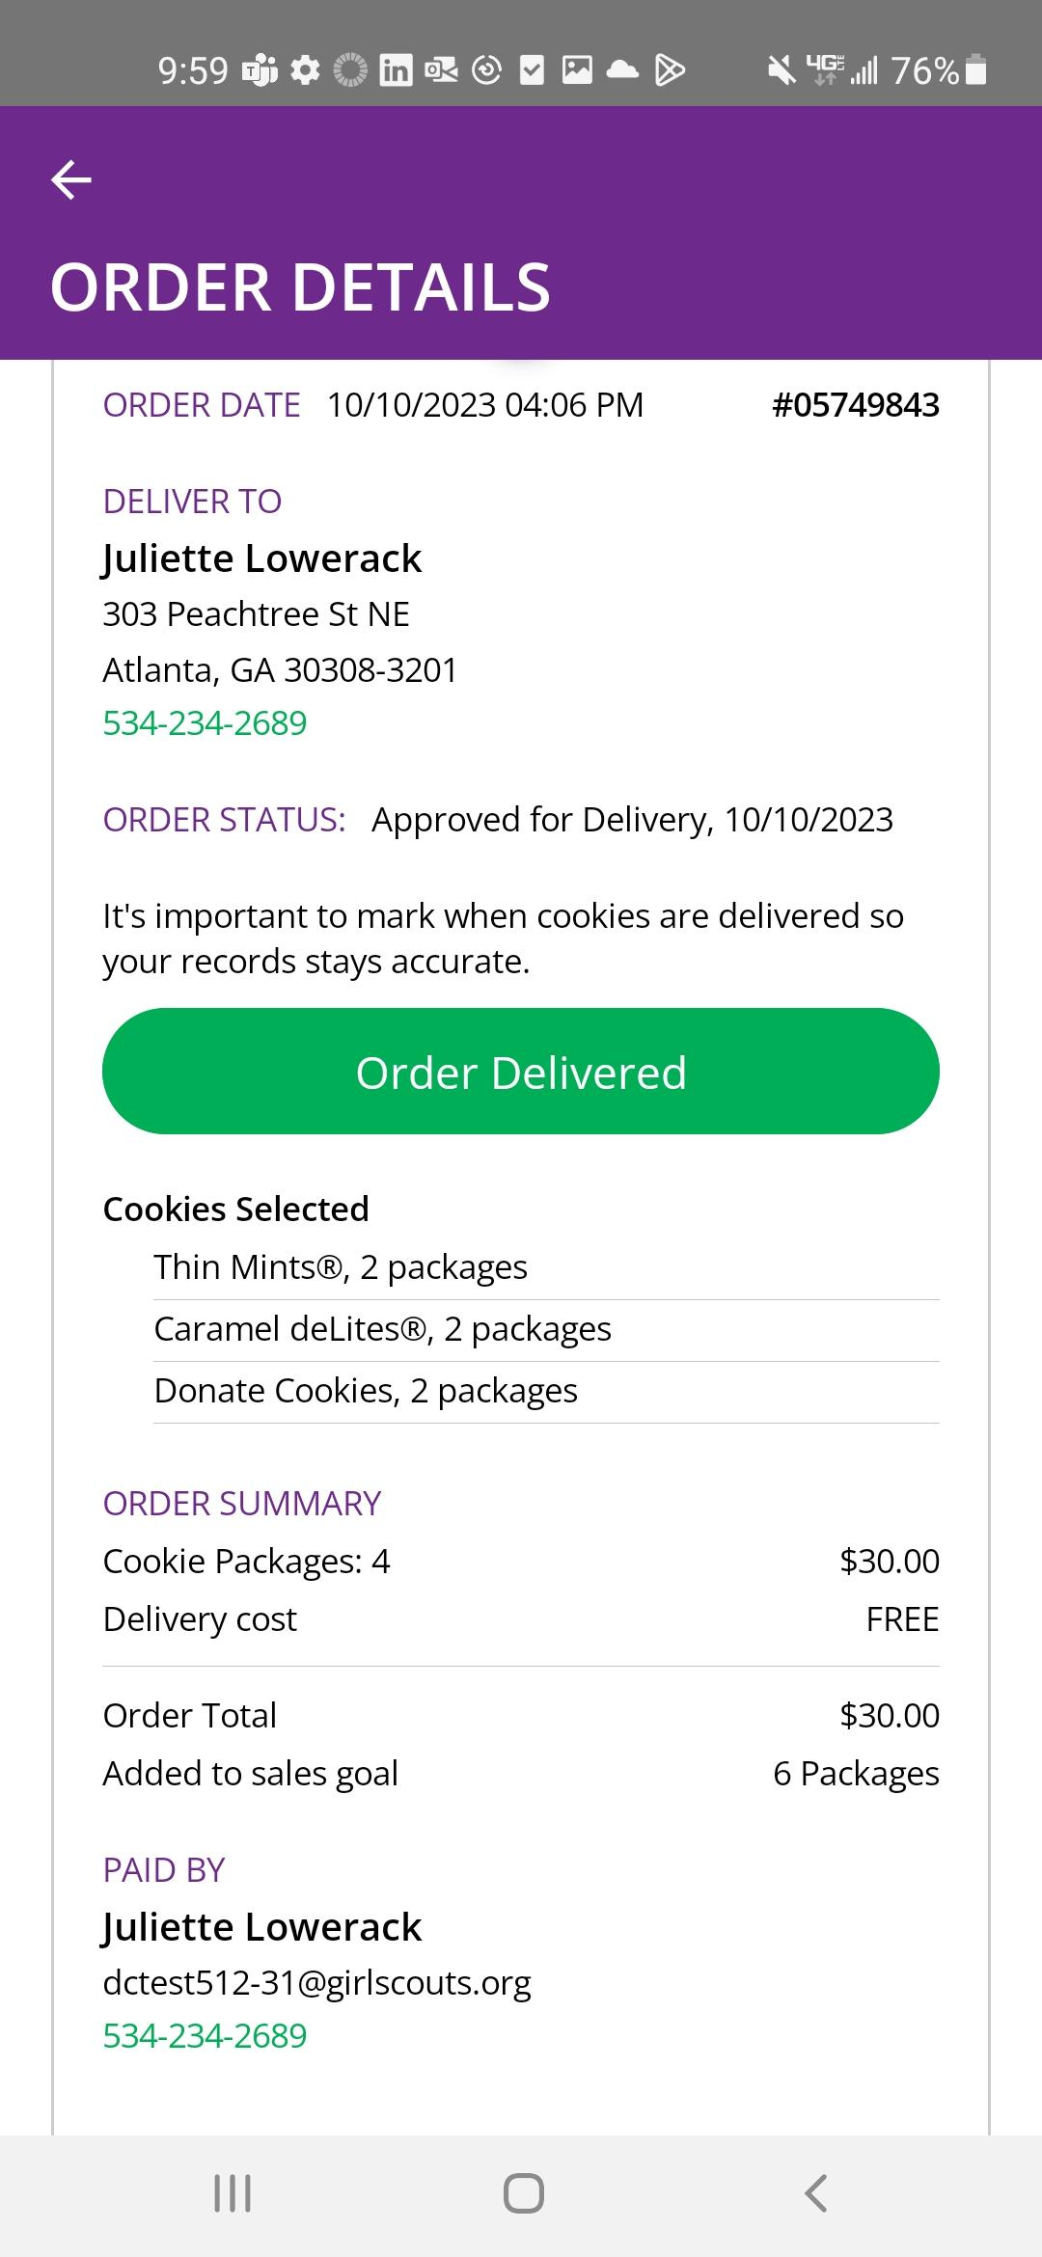
Mobile App-Viewing Orders
Order Status
Approve/ Decline Order
Click the green arrow in the section of orders you want to see more details.
Details about that customer’s order including address, packages purchased, order status, and more.
Notes:
Girl Scouts can view orders using the “All Orders” section of their app. Tapping on the “All Orders” or scrolling down will make all of your orders visible by delivery method.
To see the details for an order, click on the green arrow to view all the orders in that order type (approve for delivery, orders to deliver, shipped, etc.).
Then click the green arrow next to the specific order you want to view (not pictured above)
The details for the order will appear and you can review the order, see the status, approve/decline order, or mark order as delivered.

Slide 6
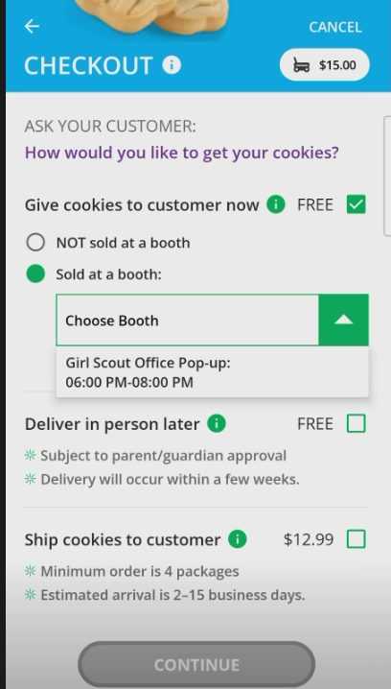
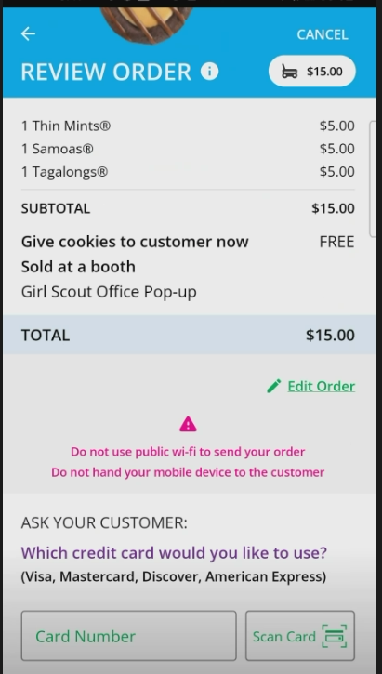
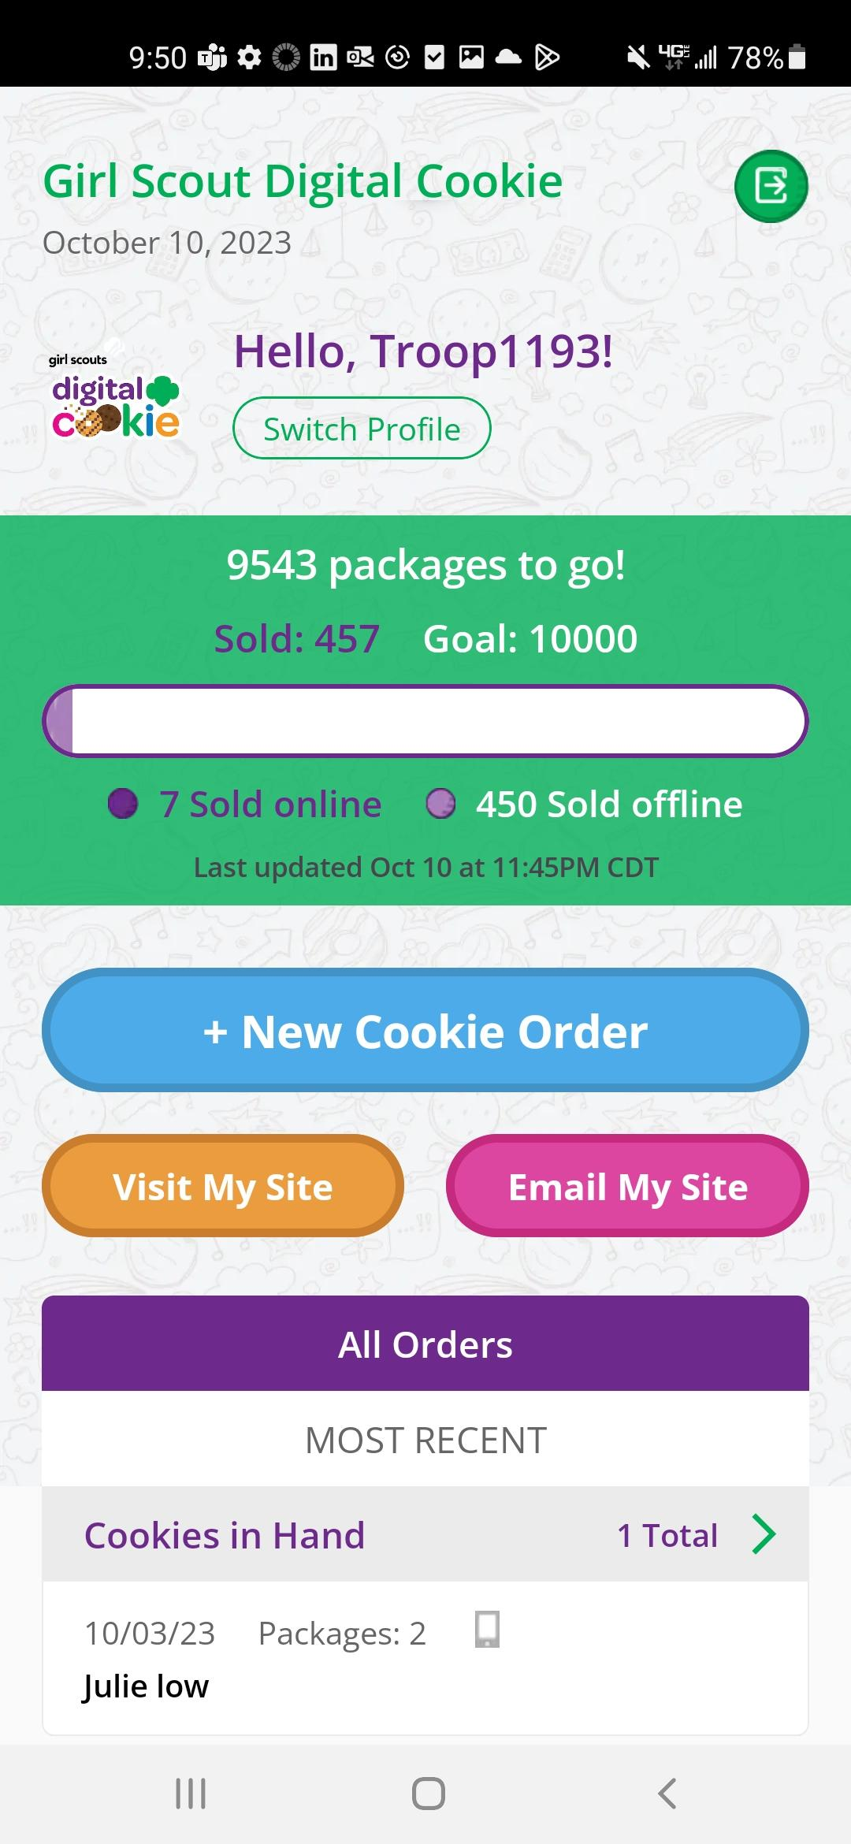
Mobile App-Troop View
Volunteers who do not have a Girl Scout can still log into Digital Cookie to use the app as the troop.
Troop View has the same options as the Girl Scout
When placing a new cookie order under the troop, users have the option to assign a specific booth to the order.
All users will be able to approve/decline troop orders.
Notes:
Note to council: not all of this may apply to you, edit as necessary.
When users are logged in as the troop, they will see the same dashboard as if they were a Girl Scout and have the same choices “New Cookie Order”, “Visit My Site,” “Email My Site,” or “All Orders.”
New Cookie Order: When processing a new order, during the checkout steps, if the selection “Give cookies to customer now” is selected the user will see additional options. Depending on the council’s settings, once a user has selected “Sold at a booth” they may be able to select that specific booth. When reviewing the order users can see which booth was selected.
Approving orders: all users when logged in as the troop will be able to view, approve/decline orders the same way Girl Scouts can above. Troop volunteers should discuss with family members how they want the troop orders to be handled prior to using the app.
Note to council: Volunteers who do not have a Girl Scout can still log into Digital Cookie to use the app as the troop.

